Slide 1

Are California's Hospitals Outsmarting SSIs? A Deep Dive into Infection Trends
Group Name: Data Dazzlers
Kiran Devihosur
Sayan Roy
Rahul Shetty
Venkata Sairam Yanamandra

Slide 2




Surgery Site Infections(SSIs)
Surgical Site Infections are infections that occur after surgery in the part of the body where the surgery took place, which can significantly affect patient recovery and outcomes
SSIs can range from superficial skin infections to more severe complications, such as infections within organs or implanted material.
In our study, we meticulously dissect California's SSI data to identify patterns and determinants. This rigorous analysis is essential, not only for postoperative care enhancement but also for honing preventive strategies against infections.

Slide 3


Relevance and Impetus
Our research is catalyzed by the historical hurdles in infection control, spotlighting the necessity for a deeper analysis
We delve into the complexities of SSI management, aiming to yield actionable insights that could reshape healthcare policies and elevate clinical practices.
he essence of our investigation lies in its potential to bolster patient safety, enhance the caliber of healthcare, and deliver cost-effective solutions.

Slide 4

Data Source
Our dataset is sourced from the extensive repository at Data.gov, specifically focusing on surgical site infections (SSIs) for various operative procedures reported by hospitals across California.
This rich dataset serves as the cornerstone of our analysis, guiding us toward insightful findings and strategic healthcare improvements.
For a deeper dive into the data's structure and scope, please visit the [catalog at Data.gov]

Slide 5

Data Cleaning
Duplicate Removal: Ensured unique data entries for accuracy.
Column Standardization: Renamed columns uniformly for coding efficiency.
Whitespace Management: Stripped extraneous spaces from strings to prevent data mismatches.
Record Filtering: Excluded data not aligning with operative procedure criteria.
Data Type Conversion: Transformed data for precise calculations and analysis.
Missing Value Imputation: Filled absent SIR_2015 data with mean values for consistency.
Data Synopsis: Total number of records before cleaning: 6452 rows and 19 columns
Total number of records after cleaning: 1863 rows and 15 columns

Slide 6

Visualization

Slide 7
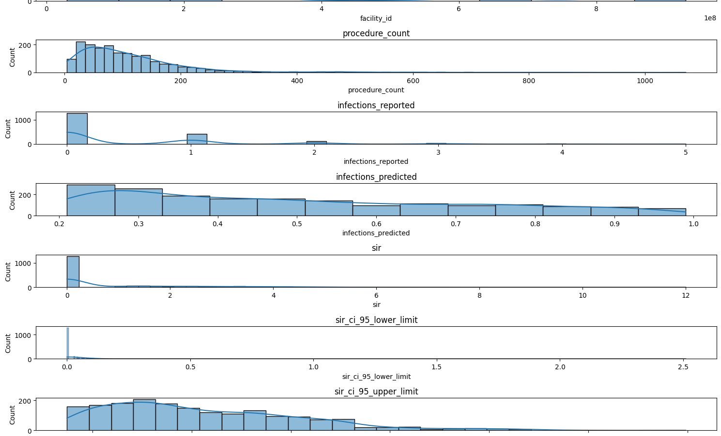
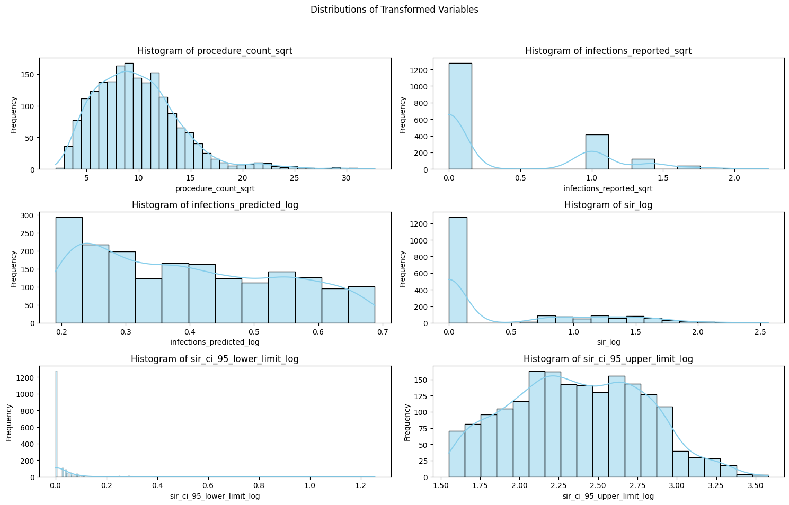
Data Transformation: Unveiling Underlying Trends
Data Skewness : Initial right-skewed distributions pose challenges for analysis.
Transformation Need: Non-normality can invalidate inferential statistics.
Square Root and Log Adjustments: Employed to address skewness and stabilize variance.
Post-Transformation Normality: Data distributions align better with normality.
Parametric Test Assumptions: Transformations meet requirements for ANOVA, regression.
Enhanced Data Interpretation: Normalized data allows for more accurate pattern analysis.
Analytical Reliability: Data transformations improve the robustness of statistical conclusions.

Slide 8

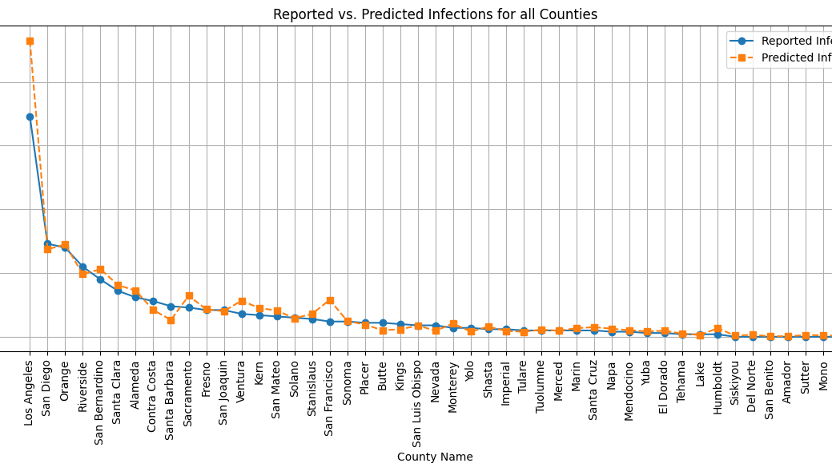
Comparative Analysis: Reported vs. Predicted SSIs

Slide 9

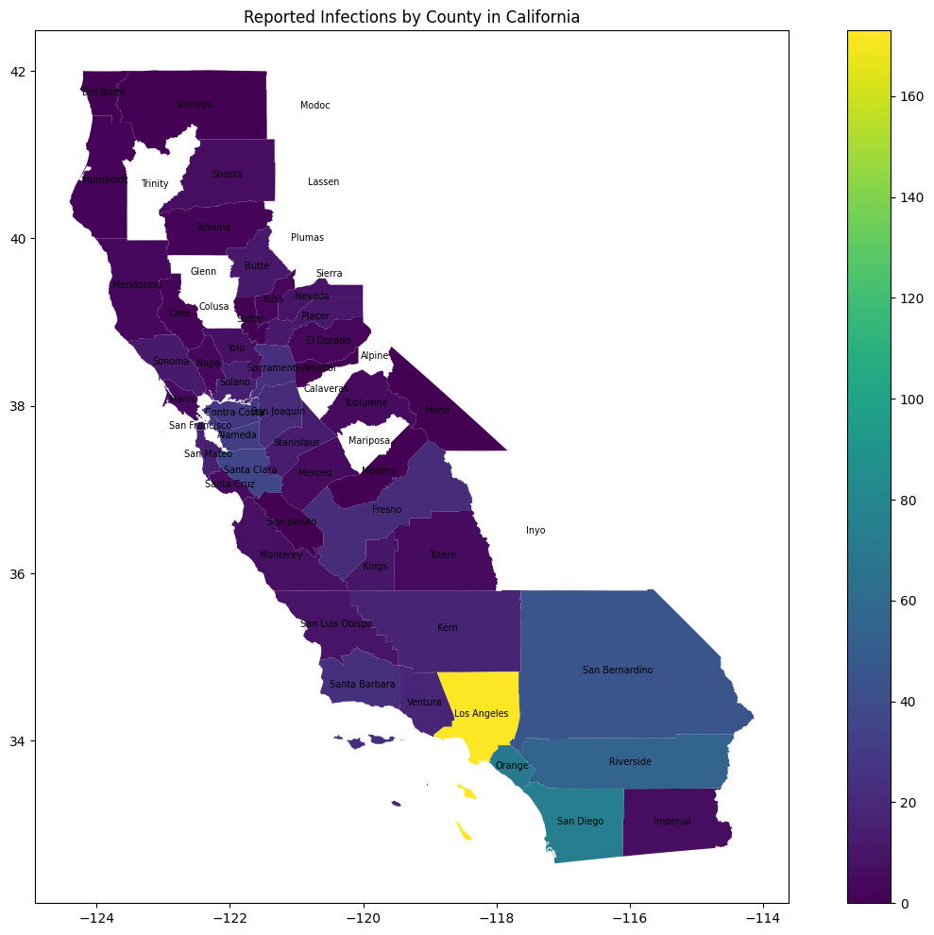
Geographical Analysis of SSI Incidence in California
Geographical Spread: Map shows SSIs reported across California by county.
Color-Coded Data: A color gradient indicates infection frequency, with darker shades representing higher numbers.
Infection Hotspots: Los Angeles County is markedly distinct, indicating a higher incidence of SSIs.
Public Health Implications: Highlights areas requiring targeted healthcare measures and resource allocation.
Strategic Planning: Aids in strategizing infection control interventions by local health departments.

Slide 10

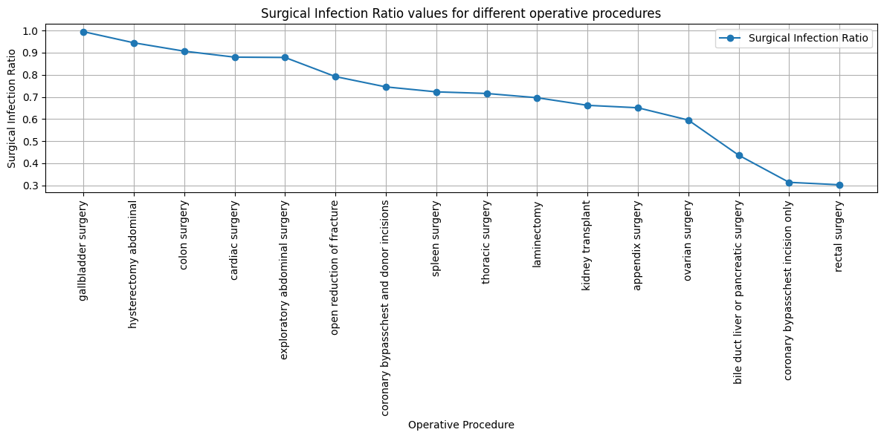
Procedure-Specific SSI Risk Assessment
Chart shows Surgical Infection Ratios for various surgeries.
SIR decreases from gallbladder to rectal surgeries.
High SIR for gallbladder, abdominal, and colon surgeries.
Cardiac and exploratory abdominal surgeries in mid-SIR range.
Lower SIR observed in kidney, appendix, ovarian, and pancreatic procedures.
Rectal surgery has the lowest SIR, indicating fewer infections than predicted.
Data suggests effectiveness of infection control varies by procedure type.
Trends could guide improvements in surgical practices and patient care.

Slide 11

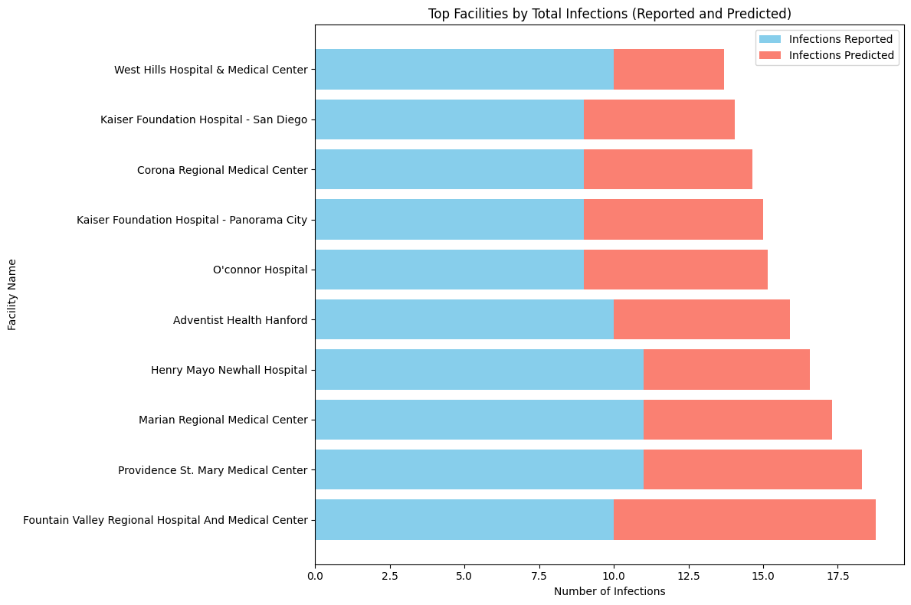
Top Facilities by Total Infections (Reported and Predicted)
The chart compares reported and predicted infection rates at healthcare facilities.
Bars represent the number of infections, with blue for reported and red for predicted.
Facilities are listed in descending order by total infections.
The chart aims to assess the accuracy of infection predictions and infection management.

Slide 12

Hypothesis

Slide 13

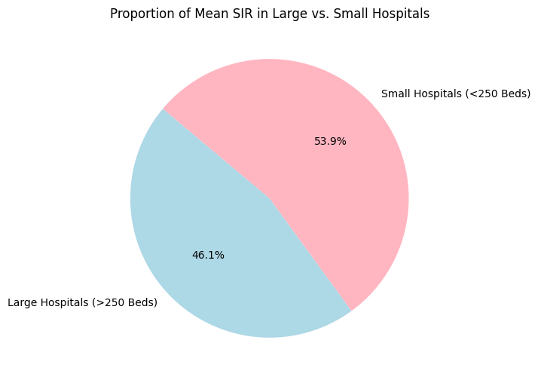
Hypothesis 1
Null Hypothesis: Hospitals with a bed capacity above 250 have a lower average SIR in comparison to smaller hospitals.
Alternative Hypothesis: Hospitals with a bed capacity above 250 have a higher average Standardized Infection Ratio (SIR) in comparison to smaller hospitals.
Objective: Explore the influence of hospital size on the Standardized Infection Ratio (SIR).
Method: Two-sample t-test comparing average SIR of large hospitals (>250 beds) with smaller ones (<125 beds and 125–250 beds).
Results:
Large Hospitals Mean SIR: 0.742
Small Hospitals Mean SIR: 0.867
t-statistic: -1.301
p-value: 0.194
Conclusion: No statistically significant difference in SIR based on hospital size.
Implications: Hospital size may not be a determinant of SIR; focus on other factors for infection control.

Slide 14
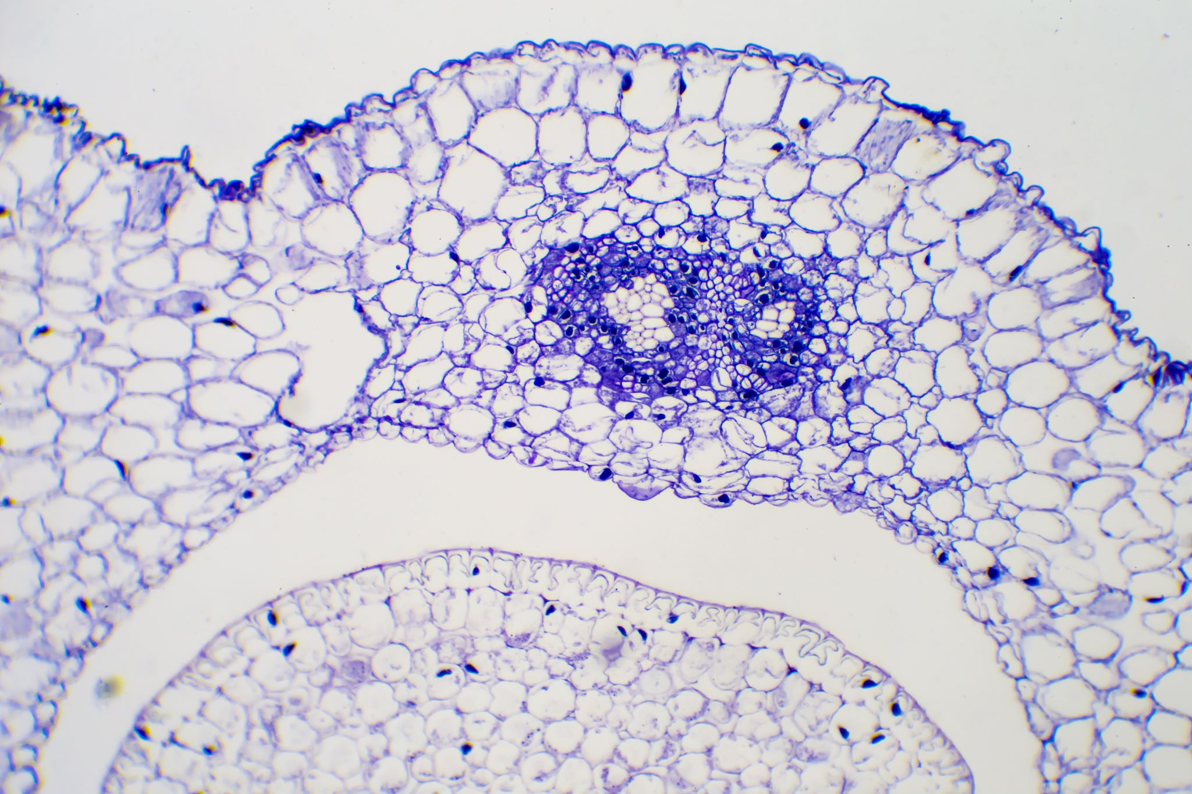
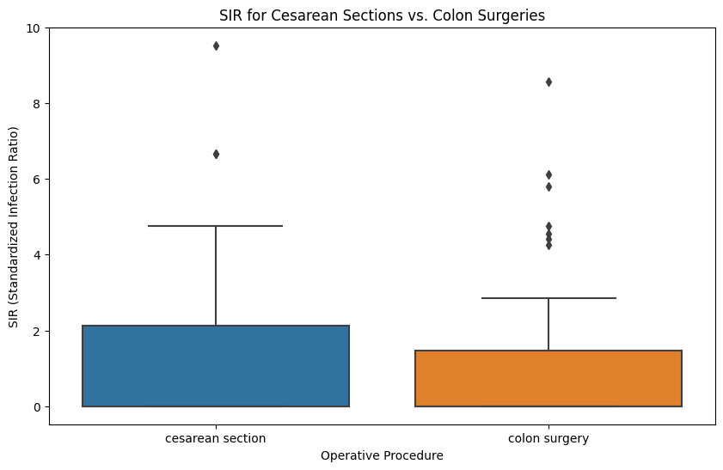
Hypothesis 2
Null Hypothesis: There is no difference in the Standardized Infection Ratios between Cesarean sections and Colon surgeries.
Alternative Hypothesis: There is a difference in the Standardized Infection Ratios between Cesarean sections and Colon surgeries.
Goal: Determine if there's a significant difference in SIR betw0een Cesarean sections and colon surgeries.
Purpose: Enhance knowledge on how surgical types influence surgical site infection rates.
Method: Utilized a two-sample t-test to compare the SIR means of Cesarean sections versus colon operations.
Results:
p-value: 0.604
t-statistic: 0.5199
Conclusion: No significant difference found in SIRs between the two surgical methods.
Implication: Suggests similar SIR risks for both procedures; underscores equal prioritization of infection control measures across diverse surgeries.

Slide 15

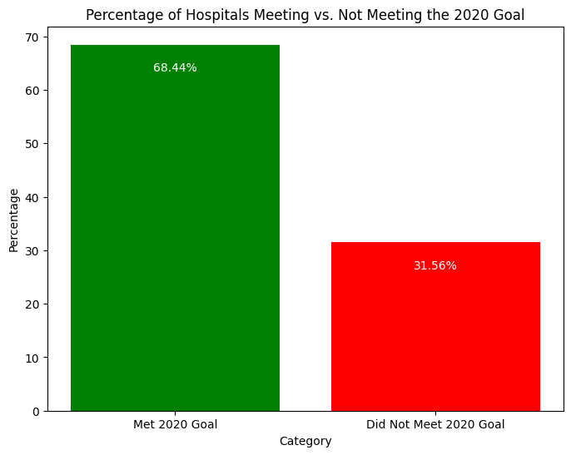
Hypothesis 3
Null Hypothesis (H0): Half of the hospitals achieved the 2020 target for reducing the Standardized Infection Ratio.
Alternative Hypothesis (H1): More than Half of the hospitals achieved the 2020 target for reducing the Standardized Infection Ratio.
Objective: Evaluate the success of hospitals in meeting the 2020 SIR target, reflecting on infection control effectiveness.
Methodology: Applied a test of proportions to determine how many hospitals met or exceeded the 2020 SIR goal, benchmarked against a hypothetical 50% achievement rate.
Key Results:
68.44% of hospitals reached the 2020 SIR goal.
Test statistic: 17.123.
P-value: 9.93 x 10 to the power of -66
Conclusions: A significantly higher proportion of hospitals than the hypothesized 50% have met the SIR target, indicating substantial progress in infection control.
Implications: Demonstrates the healthcare sector's commitment to patient safety and quality care, and provides a benchmark for future improvements in infection control practices.

Slide 16

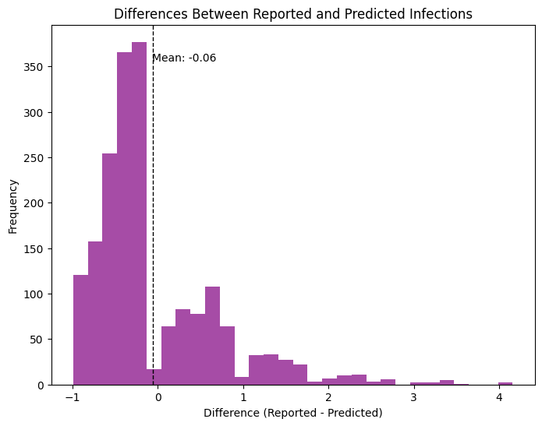
Hypothesis 4:
Null Hypothesis: The mean reported infections are lower than the mean projected infections.
Alternative Hypothesis: The mean reported infections are not lower than the mean projected infections.
Statistical analysis(t-test) reveals fewer reported SSIs compared to predicted, indicated by a negative t-statistic.
A p-value (0.0006) lower than the standard alpha level of 0.05 highlights this difference as statistically significant. Conclusion:
Statistical analysis confirms a significant gap between actual reports and model projections, validating the hypothesis.
Discrepancies could be due to evolving infection control practices not captured by models or underreporting.
The histogram visualizes the distribution of differences, emphasizing the need for improved data accuracy and model refinement.

Slide 17

Conclusion
Hospital size and surgical procedure types do not significantly impact SSI rates.
Over 50% of hospitals met or surpassed the 2020 SSI reduction targets by 2022.
There is a consistent pattern of reported SSIs being lower than predicted across hospitals.
These findings underline effective infection control and the need for improved SSI prediction and reporting methods.

Slide 18

References
1. Strategies to Prevent Surgical Site Infections in Acute Care Hospitals: 2014 Update 2. Surgical site infections: epidemiology, microbiology and prevention
3. Surgical site infections post cesarean section and associated risk factors: a retrospective case-control study at a tertiary hospital in Kenya
4. Risk factors for surgical site infection after cesarean delivery: A case-control study
5. Surgical site infection after cesarean section: Implementing 3 changes to improve the quality of patient care
6. Preventing surgical site infection. Where now?
7. Surgical Site Infections

